Slide 1

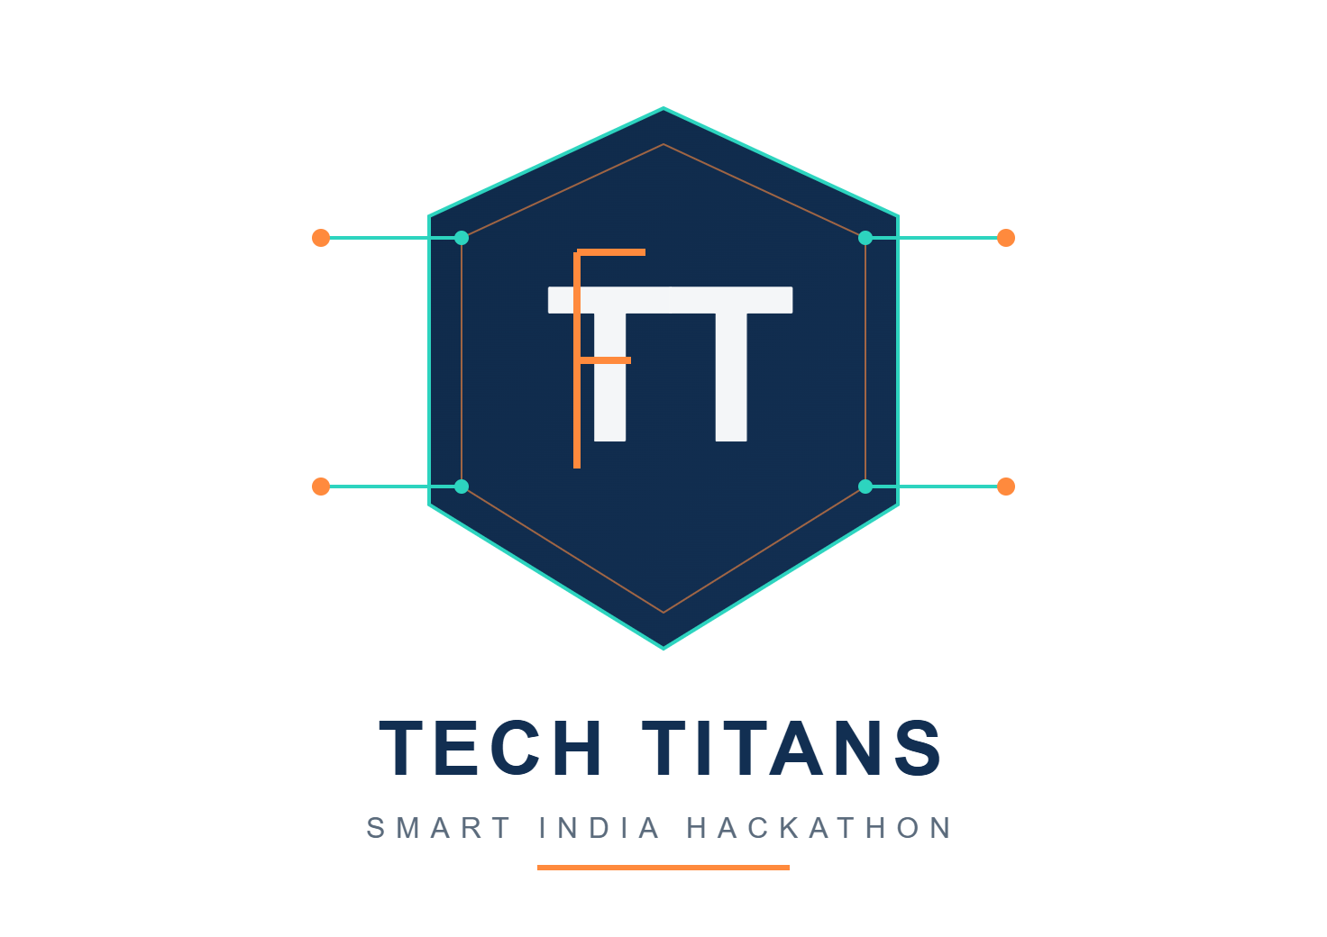

SMART INDIA HACKATHON 2026
DRIFT- Don’t wander, arrive!
Problem Statement ID - 26044
Problem Statement Title - Portal for Academia : Industry Collaboration
Theme - Smart education
Team ID: SIH26-A0H-T135
PS Category - Software
Team Name - Tech Titans

Slide 2
Drift - "One platform. Every student's next step."
PROPOSED SOLUTION
Problem at hand
Key Features
1.Too Much Info: Students get lost trying to pick the right resources and courses. 2.No Real Guidance: There’s no clear roadmap for learning or skill growth. 3.Scattered Opportunities: Internships, hackathons, and projects all live in different places.
4. Lost Progress: They struggle to track what they've learned .
Track and Grow
Built for students
Drift - The ultimate solution!!!
Personalized Roadmaps: AI builds a learning path that fits each student’s goals.
Curated Resources: Handpicked courses, articles, videos, and practice sets.
One-Stop Opportunities Hub: Internships, hackathons, and events—all together.
Progress Tracking: Log skills, certificates, and achievements in one place.
Community Connect: Find peers, mentors, and industry experts easily.
Location-Based Matches: Spot local opportunities with smart maps.
All in one
Stay ahead
Smart and personalized
Location enabled chances

Slide 3
TECHNICAL APPROACH
How We’ll Build It:
Frontend: HTML, CSS, JavaScript or React—quick, responsive, easy to use.
Backend: Python with Flask or FastAPI—solid, reliable.
Database: MySQL or PostgreSQL—store everything safely.
AI/ML: Analyze skills, match students to the right opportunities.
Maps: Use Google Maps or OpenStreetMap to show local offers.

Slide 4
FEASIBILITY AND VIABILITY
Feasibility
Viability
Challenges
Students get all the internships, training, and placements in one place.
Recruiters find candidates who actually fit—by skill, interest, and location. Institutions track skills and placements in real time.
Academicians connect students with real industry projects and proper mentors.
-Closing the skill-opportunity gap
- Keeping data accurate and verified
- Smart, precise matching
- Protecting privacy and security
- Integrating location in a seamless way
–Helping students actually adopt and stick with the platform
Students: Find relevant internships, training and placement opportunities in one platform.
Recruiters: Discover candidates based on skills, interests and location .
Institutions: Track student skills, internships and placement progress.
Academicians: Connect students with industry projects, mentors and training.
Scalable: Can expand from individual institutions to universities and industries across India.
High Impact: Bridges the gap between education, skills, internships and employment.

Slide 5
IMPACT AND BENEFITS
IMPACT
BENEFITS
Both students and recruiters win—less searching, more finding.
Growth and skills become the focus, not just chasing opportunities.
Social: Skills matter more than connections.
Economic: Students help local businesses, and get true work experience.
Educational: Building your career starts to feel like leveling up in a game.
Efficiency: No more wasted time on mismatched resumes or random searches.

Slide 6
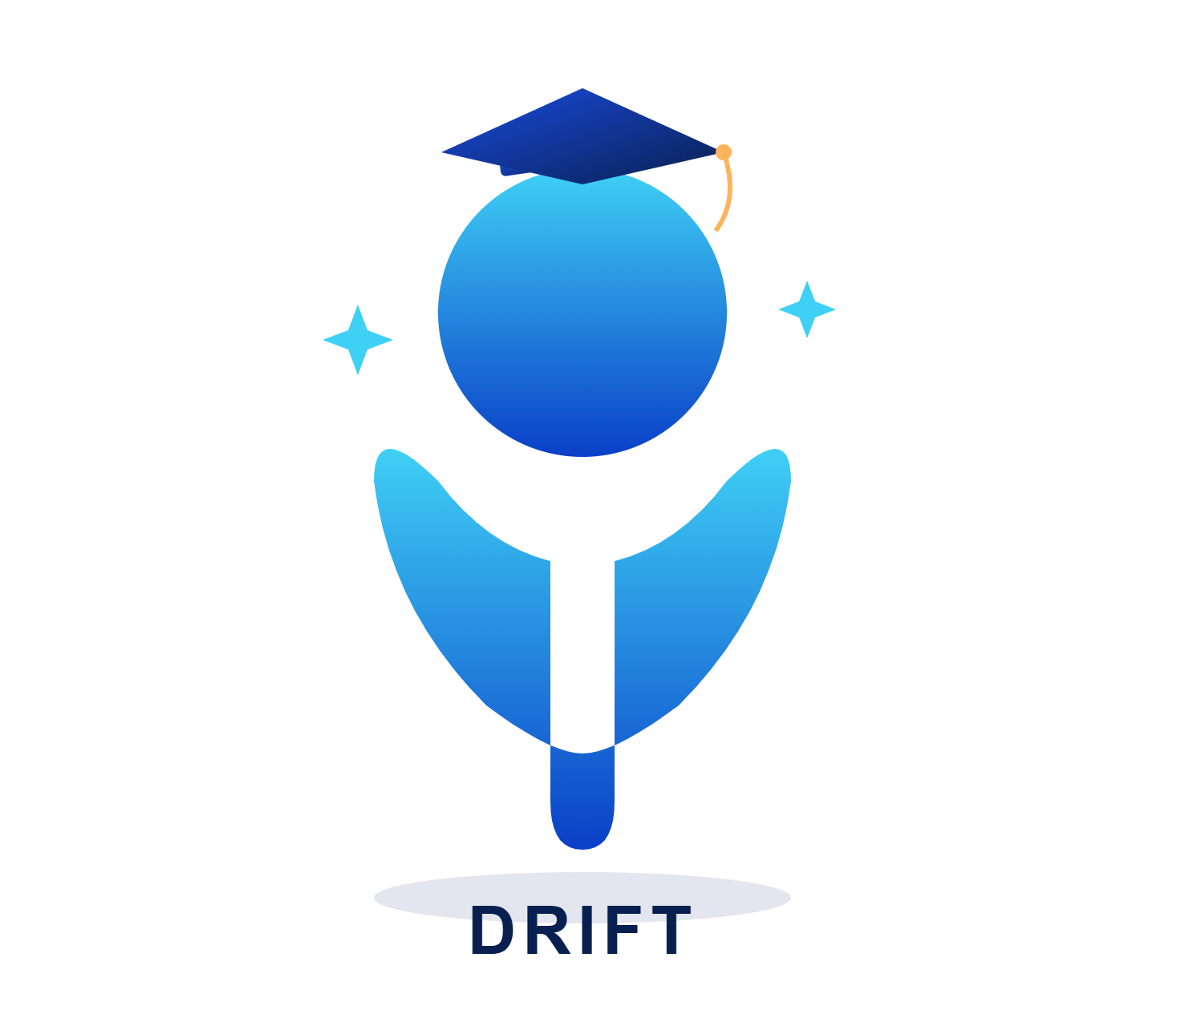
RESEARCH AND REFERENCES
https://www.ayush.gov.in/
https://www.linkedin.com/jobs/
https://internship.aicte-india.org/
https://internshala.com/
https://maps.google.com/
https://devfolio.co/

